Slide 1


Slide 2
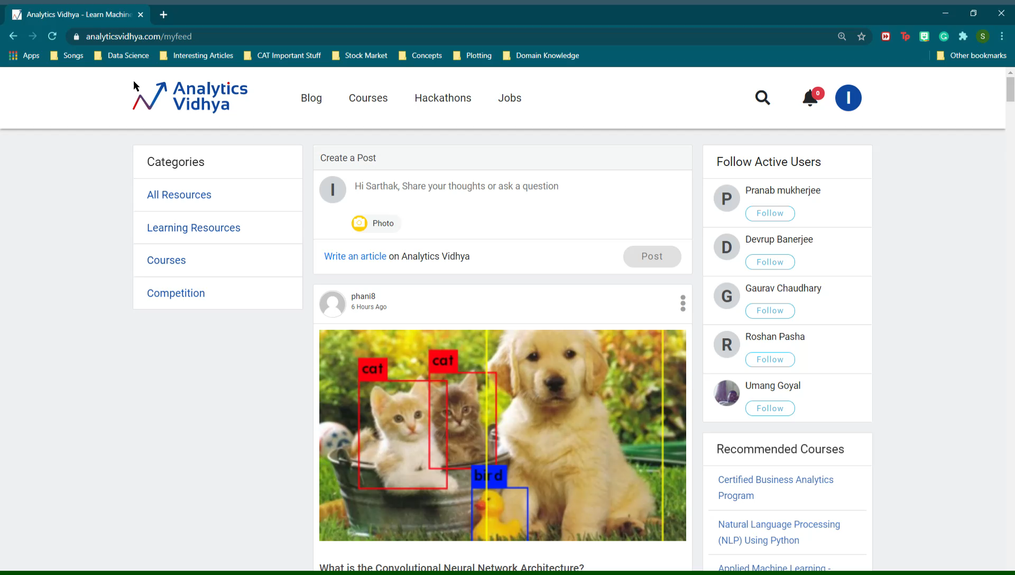


Slide 3
PROBLEM STATEMENT

Slide 4
PROBLEM STATEMENT
Based on historical data, we have to predict the number of total articles that will be read in the upcoming two weeks.

Slide 5
DATASET

Slide 6
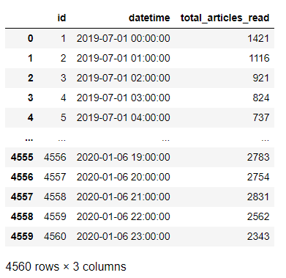
DATASET

Slide 7
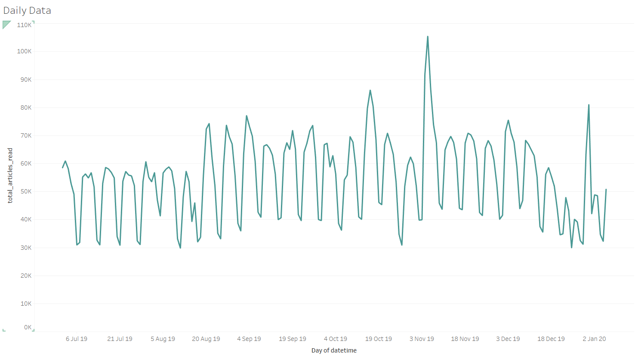

Slide 8
Weekly Pattern

Slide 9
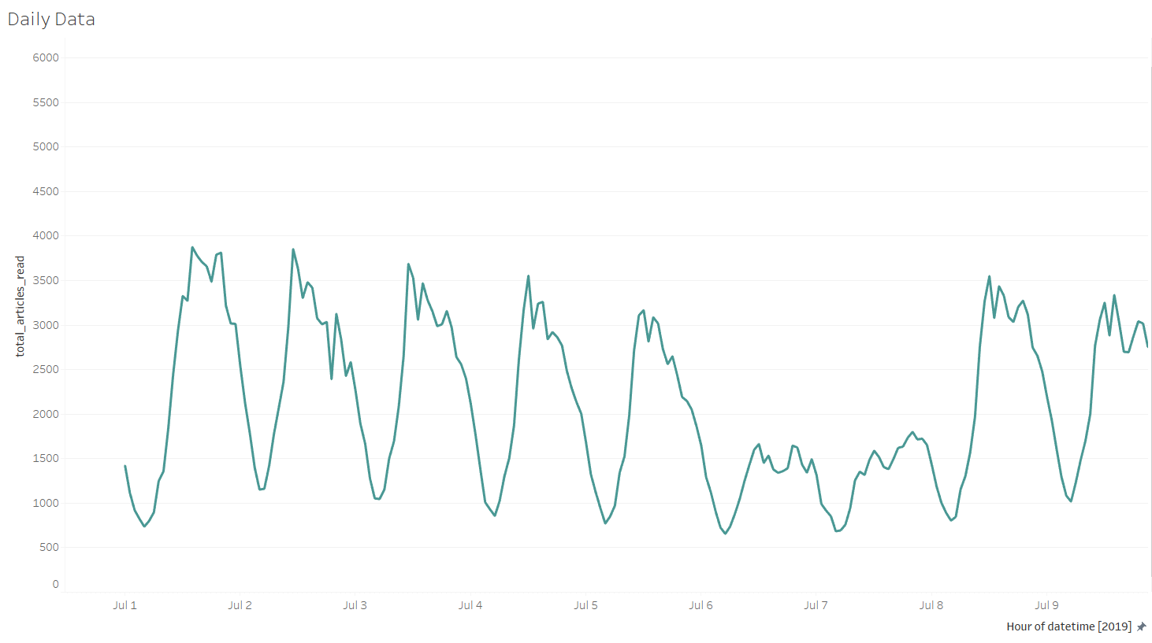

Slide 10
Daily Pattern

Slide 11
STATIONARITY TEST

Slide 12
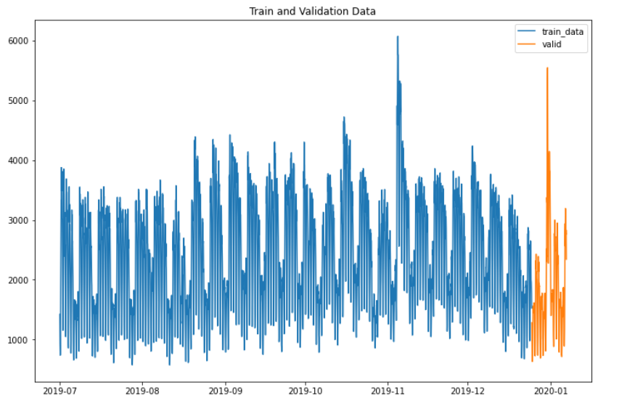
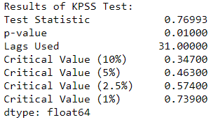
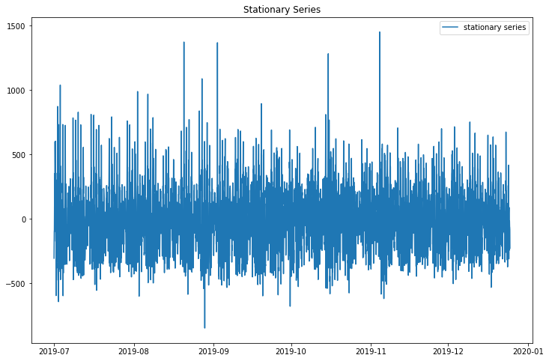
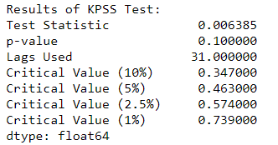

Slide 13
ACF and PACF

Slide 14
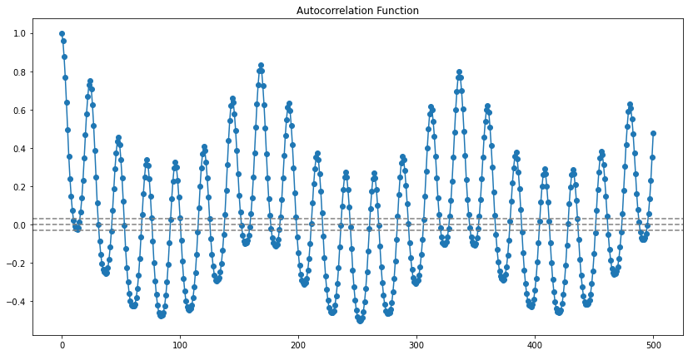
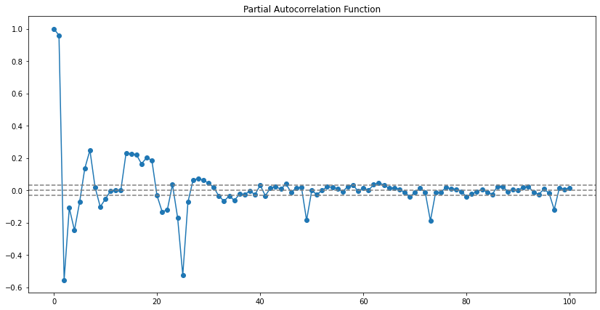

Slide 15
VALIDATION APPROACH

Slide 16
VALIDATION APPROACH

Slide 17
MODELLING

Slide 18
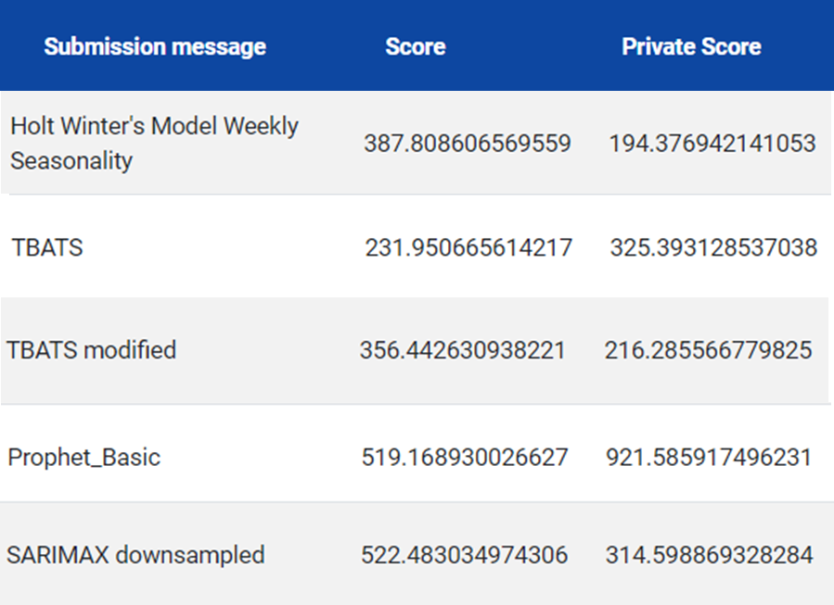
MODELLING

Slide 19
CONCLUSION

Slide 20
THANK YOU

